Slide 1
CS 4700:
Foundations of Artificial Intelligence
Prof. Bart Selman
selman@cs.cornell.edu
Machine Learning:
Neural Networks
R&N 18.7
Intro & perceptron learning

Slide 2
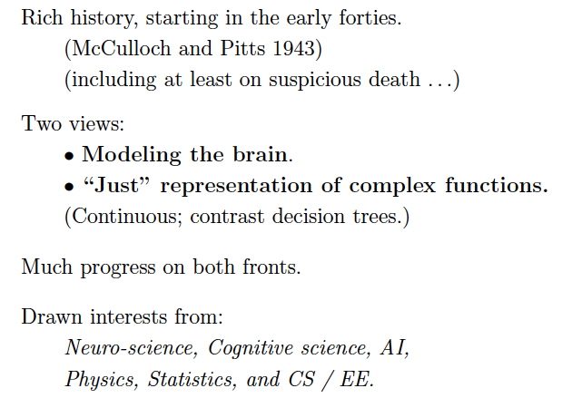

Slide 3
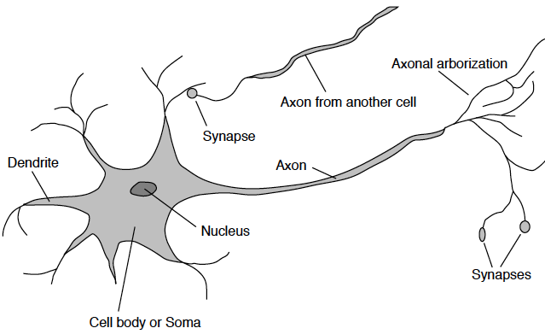
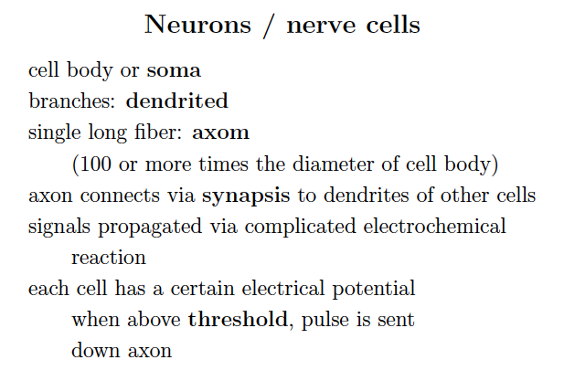
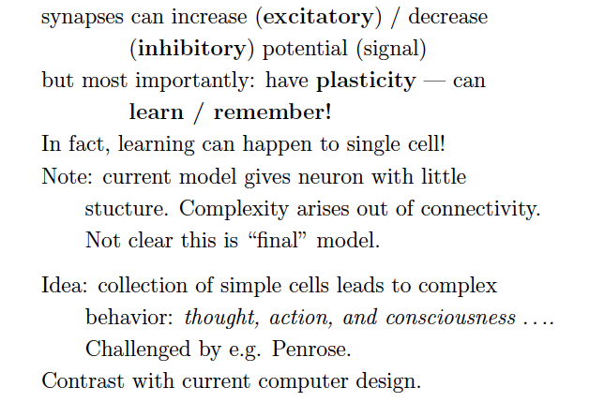
Neuron: How the brain works
# neurons ~ 100 Billion

Slide 4
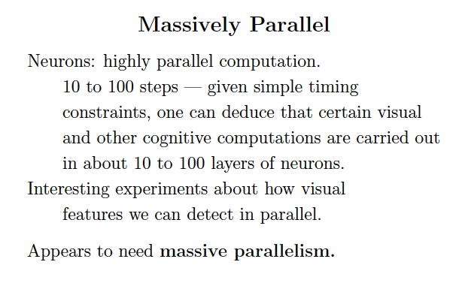
# neurons ~ 100 Billion
Why not build a model like a network of neurons?

Slide 5
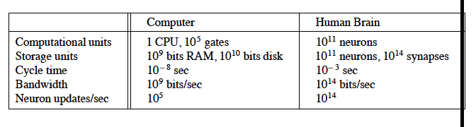

Slide 6
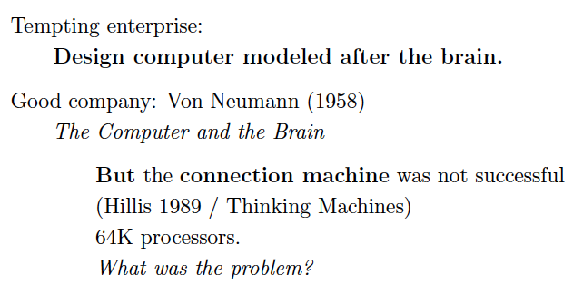

Slide 7
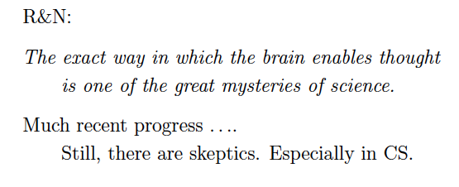

Slide 8
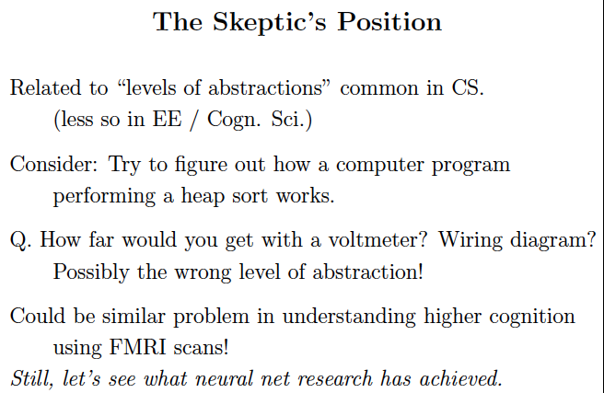

Slide 9
New York Times: “Scientists See Promise in Deep-Learning
Programs,” Saturday, Nov. 24, front page.
http://www.nytimes.com/2012/11/24/science/scientists-see-advances-in-deep-learning-a-part-of-artificial-intelligence.html?hpw
Multi-layer neural networks, a resurgence!
Winner one of the most recent learning competitions
Automatic (unsupervised) learning of “cat” and “human face” from 10 million of Google images; 16,000 cores 3 days; multi-layer neural network (Stanford & Google). ImageNet http://image-net.org/
Speech recognition and real-time translation (Microsoft Research, China).
Aside: see web site for great survey article
“A Few Useful Things to Know About
Machine Learning” by Domingos, CACM, 2012.

Slide 10
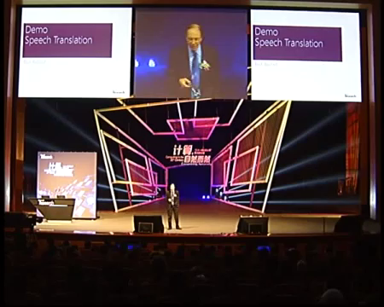
Start at min. 3:00. Deep Neural Nets in speech recognition.

Slide 11
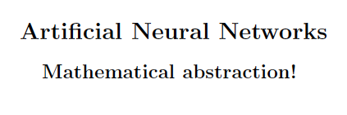

Slide 12
Basic Concepts
A Neural Network maps a set of inputs to a set of outputs
Number of inputs/outputs is variable
The Network itself is composed of an
arbitrary number of nodes or units, connected
by links, with an arbitrary topology.
A link from unit i to unit j serves to propagate the activation a_{i} to j, and it has a weight W_{ij}.
What can a neural networks do?
Compute a known function / Approximate an unknown function
Pattern Recognition / Signal Processing
Learn to do any of the above

Slide 13
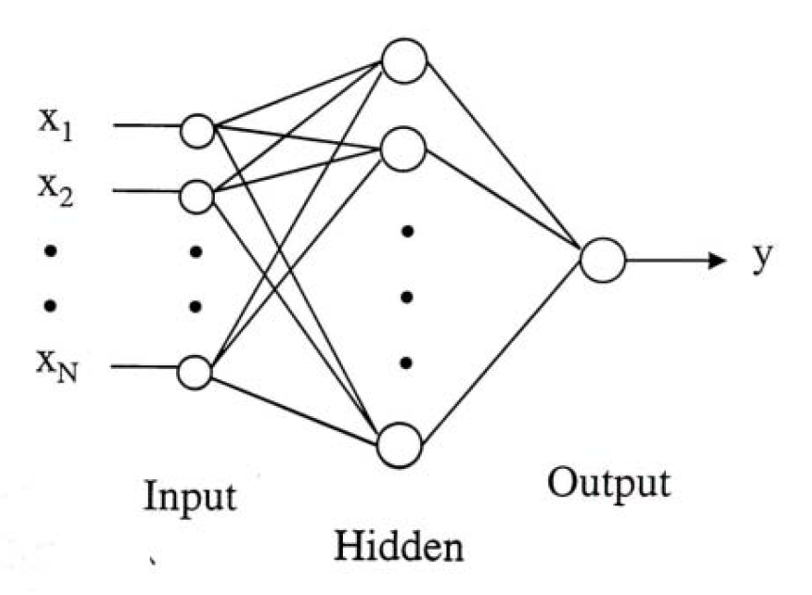
Different
types of nodes

Slide 14
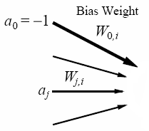
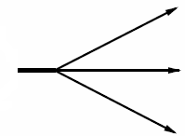


An Artificial Neuron
Node or Unit:
A Mathematical Abstraction
here
Artificial Neuron,
Node or unit ,
Processing Unit i
Input
function(in_{i}):
weighted sum
of its inputs,
including
fixed input a₀.
Output
  Input edges,
  each with weights
  (positive, negative, and
  change over time,
  learning)
Activation
function (g)
applied to
input function
(typically
non-linear).
  Output edges,
  each with weights
  (positive, negative, and
  change over time,
  learning)
→ a processing element producing an output based on a function of its inputs
Note: the fixed input and bias weight are conventional; some authors instead, e.g., or a₀=1 and -W_{0i}
Notes:
A Node is a processing element which produces an output based on a function of it’s inputs:
Winston, p. 445
Simulated neuron is viewed as a…Node connected to other nodes.
Links are the axons and dendrites.
Link associated with a weight. Like a synapse, that weight determines the nature and strength of one node’s influence on another.
Weights are the primary means for long-term storage (plasticity).
One node’s influence on another is the output value of the first times the weight on the connecting link. Large/small, +/- weight corresponds to strong/weak excitation/inhibition. (Models combining influences of set of dendrites).
Output of each node is determined by an activation function. Usually a threshold function. Combines the influences from input links. Sum of weighted inputs. Output is either 0 or 1. (Models the cell body.)
Note: Many facets of real neurons are NOT modeled.

Slide 15
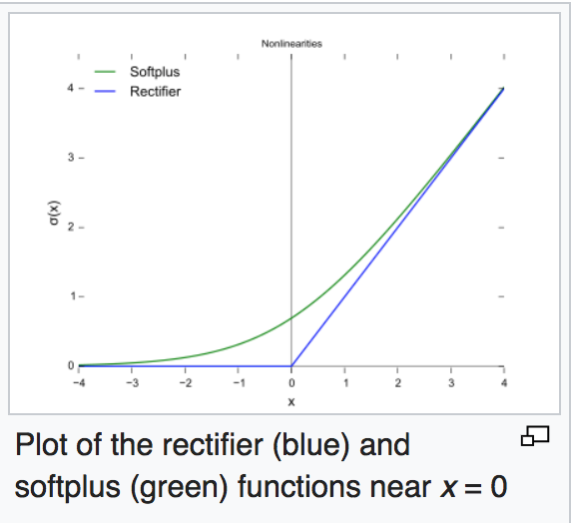
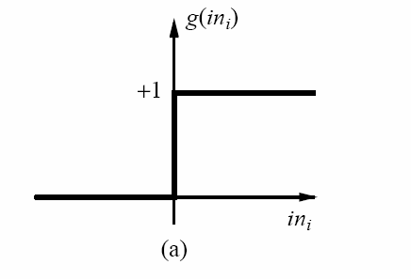
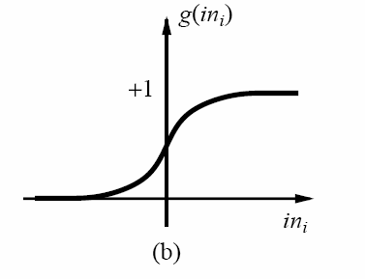
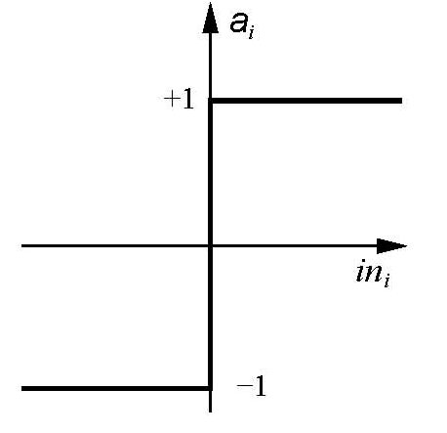

Activation Functions
ReLU ---
Rectifier Linear Unit
(deep learning)
Threshold activation function → a step function or threshold function
(outputs 1 when the input is positive; 0 otherwise).
(b) Sigmoid (or logistics function) activation function (key advantage: differentiable)
(c) Sign function, +1 if input is positive, otherwise -1.
These functions have a threshold (either hard or soft) at zero.
→ Changing the bias weight W_{0,i} moves the threshold location.

Slide 16

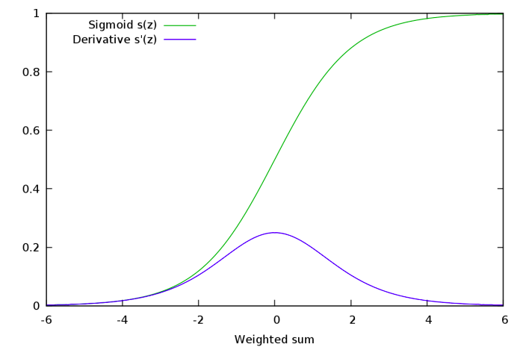
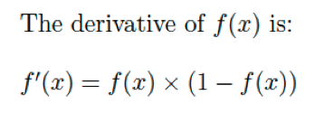
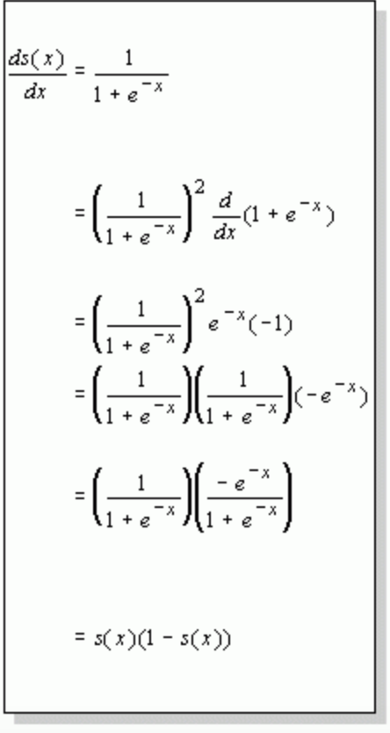
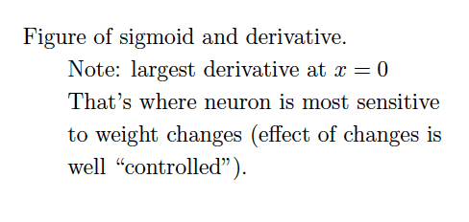

Slide 17

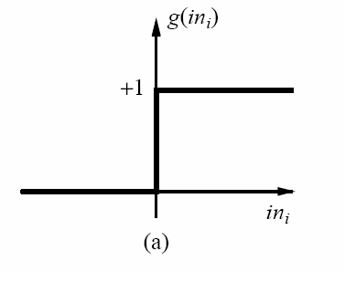
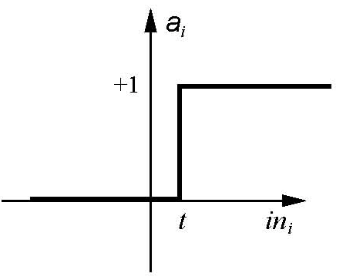

Threshold Activation Function
  Input edges,
  each with weights
  (positive, negative, and
  change over time,
  learning)
θ_{i} threshold value associated with unit i
θ_{i}=0
θ_{i}=t

Slide 18
Implementing Boolean Functions
Units with a threshold activation function
can act as logic gates; we can use these units
to compute Boolean function of its inputs.
Activation of
threshold units when:

Slide 19

Historical context: Modeling neurons in our brain as logical gates was a key event in viewing ”thinking as computation.”
The rest is history… ☺

Slide 20
Boolean AND
input x1 | input x2 | ouput
0 | 0 | 0
0 | 1 | 0
1 | 0 | 0
1 | 1 | 1
W₀?
w₀= 1.5
-1
w₁=1
w₂=1
x₁
x₂
Activate
threshold unit when:
What should W₀ be?

Slide 21
Boolean OR
input x1 | input x2 | ouput
0 | 0 | 0
0 | 1 | 1
1 | 0 | 1
1 | 1 | 1
w₀?
w₀= 0.5
-1
w₁=1
w₂=1
x₁
x₂
Activation of
threshold units when:
What should W₀ be?

Slide 22
Inverter
input x1 | output
0 | 1
1 | 0
Bla
w₀= -0.5
-1
w₁= −1
x₁
Activation of
threshold units when:

Slide 23
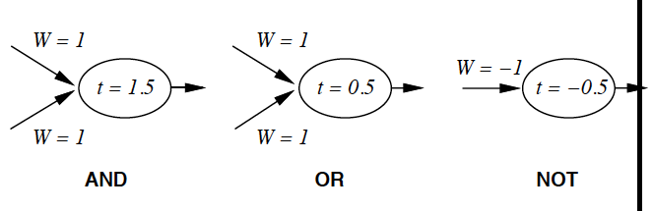

Slide 24
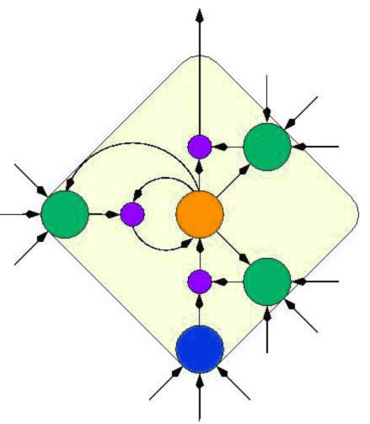
Network Structures
Acyclic or Feed-forward networks
Activation flows from input layer to
output layer
  single-layer perceptrons
  multi-layer perceptrons
Recurrent networks
  Feed the outputs back into own inputs
    Network is a dynamical system
    (stable state, oscillations, chaotic behavior)
    Response of the network depends on initial state
  Can support short-term memory
  More difficult to understand
Our focus
Feed-forward networks implement functions,
have no internal state (only weights).
Notes:
There are two major network structures using these units.
The first one is a feed-forward network.
It’s just an arbitrary function of its current inputs.
And there is no internal state other than weights.
The second one is a recurrent network.
This kind of network feeds its outputs back into its own inputs.
This structure can support a short-term memory.
But it’s rather difficult to understand.

Slide 25
Recurrent Networks
Can capture internal state (activation keeps going around);
→ more complex agents.
Brain cannot be a just a feed-forward network!
Brain has many feed-back connections and cycles
→ brain is a recurrent network!
Two key examples:
Hopfield networks:
Boltzmann Machines .

Slide 26
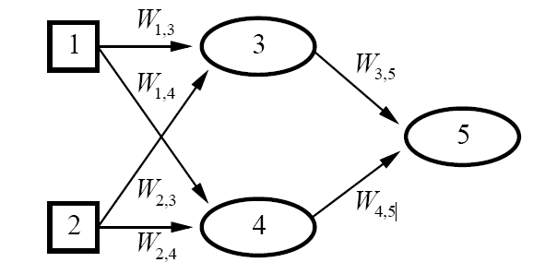

Feed-forward Network:
Represents a function of Its Input
Two input units
Two hidden units
One Output
Each unit receives input only
from units in the immediately
preceding layer.
(Bias unit omitted
for simplicity)
Given an input vector x = (x₁,x₂), the activations of the input units are set to values of the
input vector, i.e., (a₁,a₂)=(x₁,x₂), and the network computes:
Weights are the parameters of the function
Feed-forward network computes a parameterized family of functions h_{W}(x)
By adjusting the weights we get different functions:
that is how learning is done in neural networks!
Note: the input layer in general does not include computing units.
Notes:
We can represent the output of each unit as a function of its input → the network as a whole is a function of its input
The weights act as parameters
The network as a whole is a function of its input:
the weights correspond to parameters.
A neural network can be used for classification or regression. For Boolean classification
with continuous outputs (e.g., with sigmoid units), it is traditional to have a single output unit,
with a value over 0.5 interpreted as one class and a value below 0.5 as the other. For k-way
classification, one could divide the single output unit’s range into k portions, but it is more
common to have k separate output units, with the value of each one representing the relative
likelihood of that class given the current inp

Slide 28

Intermezzo
https://www.nytimes.com/2017/11/21/magazine/can-ai-be-taught-to-explain-itself.html

Slide 29
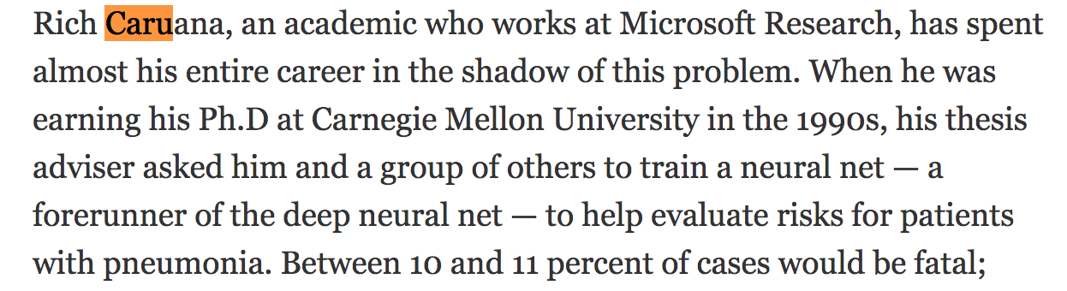
Hospital Emergency Admission Decision by Neural Net:
Risk for pneumonia --- 10/11% fatal! (early 90s)
Decide quickly, which patients to treat right away and which
ones can wait.
Neural net trained on case history. Prediction accuracy
better than human! ☺
But, Caruana: Don’t use it!
We don’t know what it does! ☹

Slide 30
Specifically:
NN learned that “asthmatic patients tend to do well” …
I.e., can be send home! (low risk…)
Why? Discovered regularity is indeed part of the data set used for training.
Hmm. What’s going on?
Analysis: Hospital staff immediately identify asthma
as serious risk. Gave best care! Patient goes home quickly…
Need for Human Interpretable AI! But at what down-side?
Compare: Decision trees vs. Neural Nets
May hurt overall performance!

Slide 31
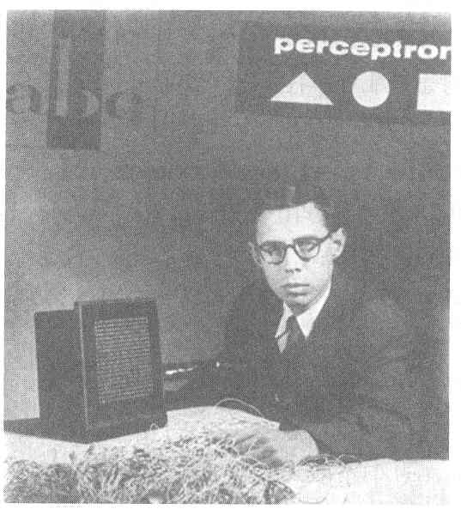
Perceptron
Cornell Aeronautical Laboratory
Perceptron
  Invented by Frank Rosenblatt in 1957 in an attempt to understand human memory, learning, and cognitive processes.
  The first neural network model by computation, with a remarkable learning algorithm:
    If function can be represented by perceptron, the learning algorithm is guaranteed to quickly converge to the hidden function!
  Became the foundation of pattern recognition research
Rosenblatt &
Mark I Perceptron:
the first machine that could "learn" to recognize and identify optical patterns.
One of the earliest and most influential neural networks:
An important milestone in AI.
Notes:
Perceptron invented by Frank Rosenblatt in 1957.
When perceptron was first introduced, this issue created considerable sensation.
Perceptron was the first neural network modeled by correct computation and affected many fields.
Perceptron also became the foundation of pattern recognition research.
<사진>
This guy is Frank Rosenblatt inventor of perceptron.
And this one is Mark ⅠPerceptron image sensor that is the first neural network equipment.

Slide 32
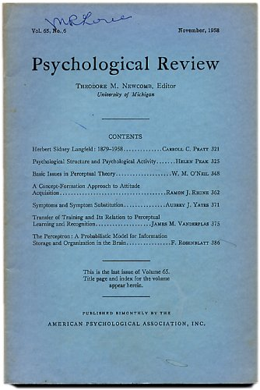
Perceptron
here
ROSENBLATT, Frank.
(Cornell Aeronautical Laboratory at Cornell University )
The Perceptron: A Probabilistic Model for Information Storage and Organization in the Brain.
In, Psychological Review, Vol. 65, No. 6, pp. 386-408, November, 1958.

Slide 33
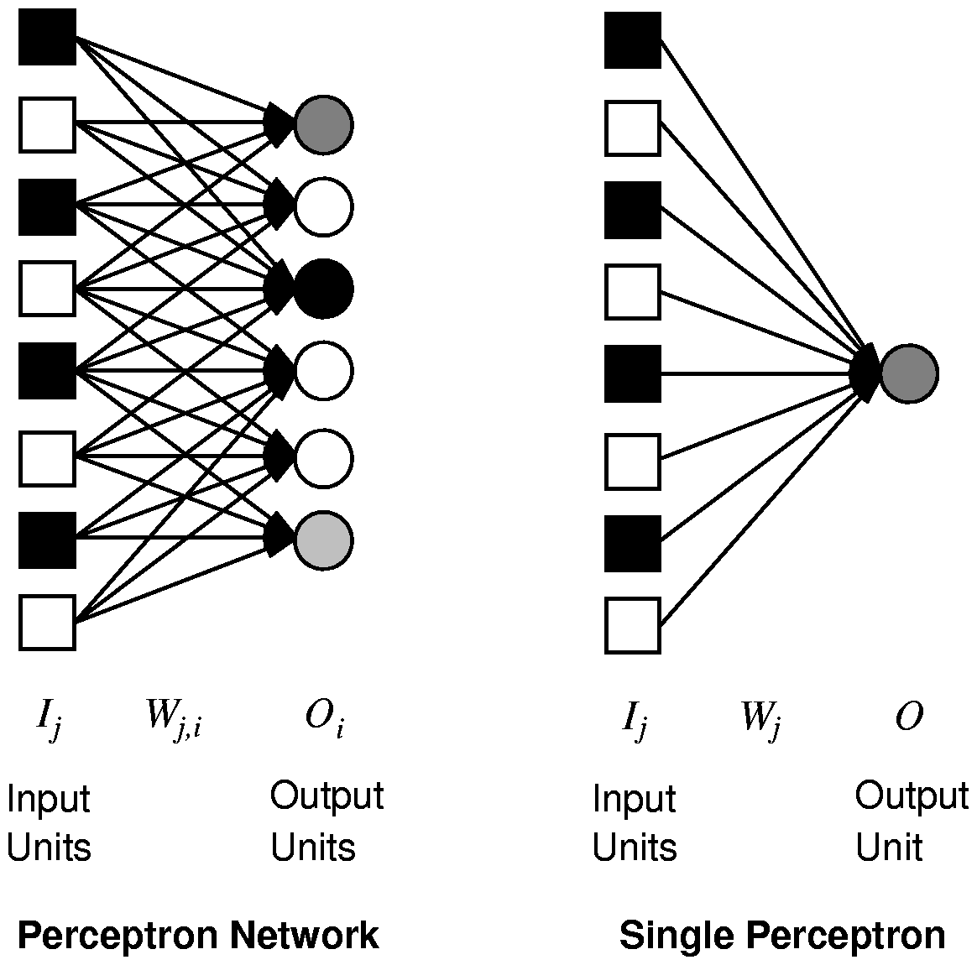
Single Layer Feed-forward Neural Networks
Perceptrons
Single-layer neural network (perceptron network)
  A network with all the inputs connected directly to the outputs
  Output units all operate separately: no shared weights
Since each output unit is
independent of the others,
we can limit our study
to single output perceptrons.
Notes:
Single layer neural network also called perceptron network is a network with all the inputs connected directly to the outputs.
<그림 a>
This is a perceptron network consisting of three perceptron output units that share five inputs. Each output unit is independent of the others.
So we can limit our study to perceptrons with a single output unit.
<그림 b> --삭제해도 무관함
This is a graph of the output of a two-input perceptron unit using a sigmoid activation function.

Slide 34

Perceptron to Learn to Identify Digits
(From Pat. Winston, MIT)
Digit | x₀ | x₁ | x₂ | x₃ | x₄ | x₅ | x₆
0 | 0 | 1 | 1 | 1 | 1 | 1 | 1
9 | 1 | 1 | 1 | 1 | 1 | 1 | 0
8 | 1 | 1 | 1 | 1 | 1 | 1 | 1
7 | 0 | 0 | 1 | 1 | 1 | 0 | 0
6 | 1 | 1 | 1 | 0 | 1 | 1 | 1
5 | 1 | 1 | 1 | 0 | 1 | 1 | 0
4 | 1 | 1 | 0 | 1 | 1 | 0 | 0
3 | 1 | 0 | 1 | 1 | 1 | 1 | 0
2 | 1 | 0 | 1 | 1 | 0 | 1 | 1
1 | 0 | 0 | 0 | 1 | 1 | 0 | 0
Seven line segments
are enough to produce
all 10 digits
2
1
3
0
6
4
5

Slide 35
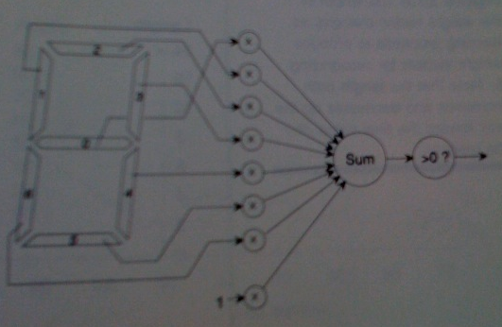
Perceptron to Learn to Identify Digits
(From Pat. Winston, MIT)
Seven line segments
are enough to produce
all 10 digits
2
1
3
0
6
4
A vision system reports which of the seven segments
in the display are on, therefore producing the inputs
for the perceptron.
5

Slide 36
Perceptron to Learn to Identify Digit 0
Digit | x₀ | x₁ | x₂ | x₃ | x₄ | x₅ | x₆ | X₇ _{(fixed input)}
0 | 0 | 1 | 1 | 1 | 1 | 1 | 1 | 1
When the input digit is 0,
what’s the value of
sum?
-1
Seven line segments
are enough to produce
all 10 digits
0
0
0
0
0
2
1
1
3
0
Sum>0 → output=1
Else output=0
0
6
4
A vision system reports which of the seven segments
in the display are on, therefore producing the inputs for the perceptron.
5

Slide 37
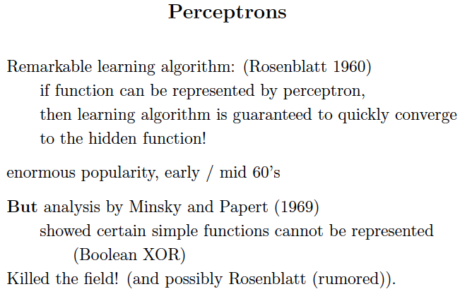
But Minsky used a simplified model. Single layer.

Slide 38
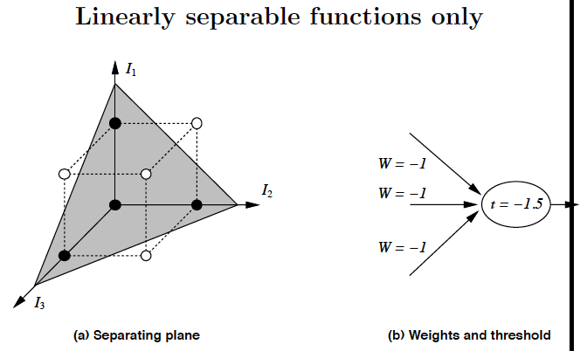
Assume: 0/1 signals. Open circles: “off” or “0”. Closed “on” or “1”.

Slide 39
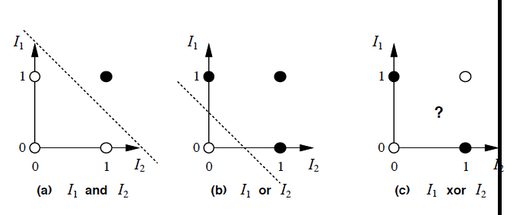
XOR: Try solving
equations for
weights! (with threshold).
Show unsolvable.

Slide 40
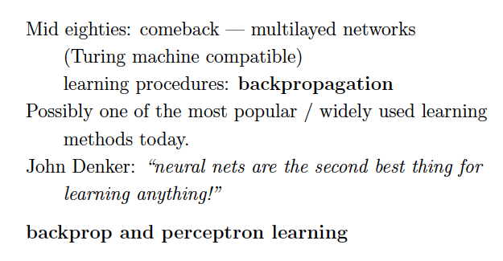
Update: or perhaps the best! ☺

Slide 41
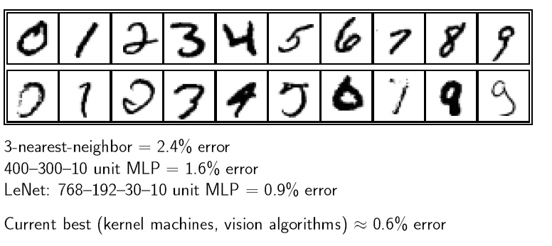
Handwritten digit recognition
(more specialized)
But, deep neural nets even better!

Slide 42
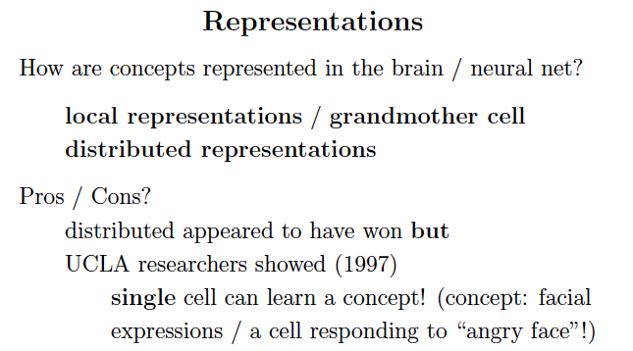
Note: can discover hidden features (“regularities”)
unsupervised with multi-layer networks.

Slide 43
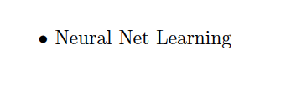

Slide 44
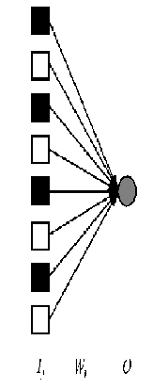
Perceptron Learning:
Intuition
Weight Update
→ Input I_{j} (j=1,2,…,n)
→ Single output O: target output, T.
Consider some initial weights
Define example error: Err = T – O
Now just move weights in right direction!
If the error is positive, then we need to increase O.
Err >0 → need to increase O;
Err <0 → need to decrease O;
Each input unit j, contributes W_{j} I_{j} to total input.
So, use:
W_{j} ← W_{j} + α × I_{j} × Err
Perceptron Learning Rule (Rosenblatt 1960)
is the learning rate
(for now assume 1).
Notes:
×

Slide 45
Perceptron Learning:
Simple Example
Let’s consider an example (adapted from Patrick Wintson book, MIT)
Framework and notation:
0/1 signals
Input vector:
Weight vector:
x₀ = 1 and θ₀=-w₀, simulate the threshold.
O is output (0 or 1) (single output).
Threshold function:
Learning rate = 1.

Slide 46
Perceptron Learning:
Simple Example
Err = T – O
W_{j} ← W_{j} + α × I_{j} × Err
Set of examples, each example is a pair
i.e., an input vector and a label y (0 or 1).
Learning procedure, called the “error correcting method”
Start with all zero weight vector.
Cycle (repeatedly) through examples and for each example do:
  If perceptron is 0 while it should be 1,
add the input vector to the weight vector
  If perceptron is 1 while it should be 0,
subtract the input vector to the weight vector
  Otherwise do nothing.
This procedure provably converges
(polynomial number of steps)
if the function is represented
by a perceptron
(i.e., linearly separable)
Intuitively correct,
(e.g., if output is 0
but it should be 1,
the weights are
increased) !

Slide 47
Perceptron Learning:
Simple Example
Consider learning the logical OR function.
Our examples are:
Sample x0 x1 x2 label
1 1 0 0 0
2 1 0 1 1
3 1 1 0 1
4 1 1 1 1
Activation Function

Slide 48
Perceptron Learning:
Simple Example
Error correcting method
  If perceptron is 0 while it should be 1,
add the input vector to the weight vector
  If perceptron is 1 while it should be 0,
subtract the input vector to the weight vector
  Otherwise do nothing.
1
We’ll use a single perceptron with three inputs.
We’ll start with all weights 0 W= <0,0,0>
Example 1 I= < 1 0 0> label=0 W= <0,0,0>
Perceptron (1×0+ 0×0+ 0×0 =0, S=0) output → 0
→it classifies it as 0, so correct, do nothing
Example 2 I=<1 0 1> label=1 W= <0,0,0>
Perceptron (1×0+ 0×0+ 1×0 = 0) output →0
→it classifies it as 0, while it should be 1, so we add input to weights
W = <0,0,0> + <1,0,1>= <1,0,1>
I₀
w₀
I₁
w₁
O
I₂
w₂

Slide 49
1
Example 3 I=<1 1 0> label=1 W= <1,0,1>
Perceptron (1×0+ 1×0+ 0×0 > 0) output = 1
→it classifies it as 1, correct, do nothing
W = <1,0,1>
Example 4 I=<1 1 1> label=1 W= <1,0,1>
Perceptron (1×0+ 1×0+ 1×0 > 0) output = 1
→it classifies it as 1, correct, do nothing
W = <1,0,1>
I₀
w₀
I₁
w₁
O
I₂
w₂

Slide 50
Perceptron Learning:
Simple Example
Error correcting method
  If perceptron is 0 while it should be 1,
add the input vector to the weight vector
  If perceptron is 1 while it should be 0,
subtract the input vector from the weight vector
  Otherwise do nothing.
1
I₀
w₀
Epoch 2, through the examples, W = <1,0,1> .
Example 1 I = <1,0,0> label=0 W = <1,0,1>
Perceptron (1×1+ 0×0+ 0×1 >0) output → 1
→it classifies it as 1, while it should be 0, so subtract input from weights
W = <1,0,1> - <1,0,0> = <0, 0, 1>
Example 2 I=<1 0 1> label=1 W= <0,0,1>
Perceptron (1×0+ 0×0+ 1×1 > 0) output →1
→it classifies it as 1, so correct, do nothing
I₁
w₁
O
I₂
w₂

Slide 51
Example 3 I=<1 1 0> label=1 W= <0,0,1>
Perceptron (1×0+ 1×0+ 0×1 > 0) output = 0
→it classifies it as 0, while it should be 1, so add input to weights
W = <0,0,1> + W = <1,1,0> = <1, 1, 1>
Example 4 I=<1 1 1> label=1 W= <1,1,1>
Perceptron (1×1+ 1×1+ 1×1 > 0) output = 1
→it classifies it as 1, correct, do nothing
W = <1,1,1>

Slide 52
Perceptron Learning:
Simple Example
1
I₀
w₀
Epoch 3, through the examples, W = <1,1,1> .
Example 1 I=<1,0,0> label=0 W = <1,1,1>
Perceptron (1×1+ 0×1+ 0×1 >0) output → 1
→it classifies it as 1, while it should be 0, so subtract input from weights
W = <1,1,1> - W = <1,0,0> = <0, 1, 1>
Example 2 I=<1 0 1> label=1 W= <0, 1, 1>
Perceptron (1×0+ 0×1+ 1×1 > 0) output →1
→it classifies it as 1, so correct, do nothing
I₁
w₁
O
I₂
w₂

Slide 53
Example 3 I=<1 1 0> label=1 W= <0, 1, 1>
Perceptron (1×0+ 1×1+ 0×1 > 0) output = 1
→it classifies it as 1, correct, do nothing
Example 4 I=<1 1 1> label=1 W= <0, 1, 1>
Perceptron (1×0+ 1×1+ 1×1 > 0) output = 1
→it classifies it as 1, correct, do nothing
W = <1,1,1>

Slide 54
Perceptron Learning:
Simple Example
1
Epoch 4, through the examples, W= <0, 1, 1>.
Example 1 I= <1,0,0> label=0 W = <0,1,1>
Perceptron (1×0+ 0×1+ 0×1 = 0) output → 0
→it classifies it as 0, so correct, do nothing
I₀
W₀ =0
I₁
W₁=1
O
I₂
W₂=1
So the final weight vector W= <0, 1, 1> classifies all
examples correctly, and the perceptron has learned the function!
OR
Aside: in more realistic cases the bias (W0) will not be 0.
(This was just a toy example!)
Also, in general, many more inputs (100 to 1000)

Slide 55
Epoch | x0 | x1 | x2 | Desired Target | w0 | w1 | w2 | Output | Error | New w0 | New w1 | New w2
1 example 1 | 1 | 0 | 0 | 0 | 0 | 0 | 0 | 0 | 0 | 0 | 0 | 0
 | 1 | 0 | 1 | 1 | 0 | 0 | 0 | 0 | 1 | 1 | 0 | 1
 | 1 | 1 | 0 | 1 | 1 | 0 | 1 | 1 | 0 | 1 | 0 | 1
 | 1 | 1 | 1 | 1 | 1 | 0 | 1 | 1 | 0 | 1 | 0 | 1
2 | 1 | 0 | 0 | 0 | 1 | 0 | 1 | 1 | -1 | 0 | 0 | 1
 | 1 | 0 | 1 | 1 | 0 | 0 | 1 | 1 | 0 | 0 | 0 | 1
 | 1 | 1 | 0 | 1 | 0 | 0 | 1 | 0 | 1 | 1 | 1 | 1
 | 1 | 1 | 1 | 1 | 1 | 1 | 1 | 1 | 0 | 1 | 1 | 1
3 | 1 | 0 | 0 | 0 | 1 | 1 | 1 | 1 | -1 | 0 | 1 | 1
 | 1 | 0 | 1 | 1 | 0 | 1 | 1 | 1 | 0 | 0 | 1 | 1
 | 1 | 1 | 0 | 1 | 0 | 1 | 1 | 1 | 0 | 0 | 1 | 1
 | 1 | 1 | 1 | 1 | 0 | 1 | 1 | 1 | 0 | 0 | 1 | 1
4 | 1 | 0 | 0 | 0 | 0 | 1 | 1 | 0 | 0 | 0 | 1 | 1

Slide 56
Epoch | x0 | x1 | x2 | Desired Target | w0 | w1 | w2 | Output | Error | New w0 | New w1 | New w2
1 example 1 | 1 | 0 | 0 | 0 | 0 | 0 | 0 | 0 | 0 | 0 | 0 | 0
example 2 | 1 | 0 | 1 | 1 | 0 | 0 | 0 | 0 | 1 | 1 | 0 | 1
 | 1 | 1 | 0 | 1 | 1 | 0 | 1 | 1 | 0 | 1 | 0 | 1
 | 1 | 1 | 1 | 1 | 1 | 0 | 1 | 1 | 0 | 1 | 0 | 1
2 | 1 | 0 | 0 | 0 | 1 | 0 | 1 | 1 | -1 | 0 | 0 | 1
 | 1 | 0 | 1 | 1 | 0 | 0 | 1 | 1 | 0 | 0 | 0 | 1
 | 1 | 1 | 0 | 1 | 0 | 0 | 1 | 0 | 1 | 1 | 1 | 1
 | 1 | 1 | 1 | 1 | 1 | 1 | 1 | 1 | 0 | 1 | 1 | 1
3 | 1 | 0 | 0 | 0 | 1 | 1 | 1 | 1 | -1 | 0 | 1 | 1
 | 1 | 0 | 1 | 1 | 0 | 1 | 1 | 1 | 0 | 0 | 1 | 1
 | 1 | 1 | 0 | 1 | 0 | 1 | 1 | 1 | 0 | 0 | 1 | 1
 | 1 | 1 | 1 | 1 | 0 | 1 | 1 | 1 | 0 | 0 | 1 | 1
4 | 1 | 0 | 0 | 0 | 0 | 1 | 1 | 0 | 0 | 0 | 1 | 1

Slide 57
Epoch | x0 | x1 | x2 | Desired Target | w0 | w1 | w2 | Output | Error | New w0 | New w1 | New w2
1 example 1 | 1 | 0 | 0 | 0 | 0 | 0 | 0 | 0 | 0 | 0 | 0 | 0
example 2 | 1 | 0 | 1 | 1 | 0 | 0 | 0 | 0 | 1 | 1 | 0 | 1
example 3 | 1 | 1 | 0 | 1 | 1 | 0 | 1 | 1 | 0 | 1 | 0 | 1
 | 1 | 1 | 1 | 1 | 1 | 0 | 1 | 1 | 0 | 1 | 0 | 1
2 | 1 | 0 | 0 | 0 | 1 | 0 | 1 | 1 | -1 | 0 | 0 | 1
 | 1 | 0 | 1 | 1 | 0 | 0 | 1 | 1 | 0 | 0 | 0 | 1
 | 1 | 1 | 0 | 1 | 0 | 0 | 1 | 0 | 1 | 1 | 1 | 1
 | 1 | 1 | 1 | 1 | 1 | 1 | 1 | 1 | 0 | 1 | 1 | 1
3 | 1 | 0 | 0 | 0 | 1 | 1 | 1 | 1 | -1 | 0 | 1 | 1
 | 1 | 0 | 1 | 1 | 0 | 1 | 1 | 1 | 0 | 0 | 1 | 1
 | 1 | 1 | 0 | 1 | 0 | 1 | 1 | 1 | 0 | 0 | 1 | 1
 | 1 | 1 | 1 | 1 | 0 | 1 | 1 | 1 | 0 | 0 | 1 | 1
4 | 1 | 0 | 0 | 0 | 0 | 1 | 1 | 0 | 0 | 0 | 1 | 1

Slide 58
Epoch | x0 | x1 | x2 | Desired Target | w0 | w1 | w2 | Output | Error | New w0 | New w1 | New w2
1 example 1 | 1 | 0 | 0 | 0 | 0 | 0 | 0 | 0 | 0 | 0 | 0 | 0
example 2 | 1 | 0 | 1 | 1 | 0 | 0 | 0 | 0 | 1 | 1 | 0 | 1
example 3 | 1 | 1 | 0 | 1 | 1 | 0 | 1 | 1 | 0 | 1 | 0 | 1
example 4 | 1 | 1 | 1 | 1 | 1 | 0 | 1 | 1 | 0 | 1 | 0 | 1
2 | 1 | 0 | 0 | 0 | 1 | 0 | 1 | 1 | -1 | 0 | 0 | 1
 | 1 | 0 | 1 | 1 | 0 | 0 | 1 | 1 | 0 | 0 | 0 | 1
 | 1 | 1 | 0 | 1 | 0 | 0 | 1 | 0 | 1 | 1 | 1 | 1
 | 1 | 1 | 1 | 1 | 1 | 1 | 1 | 1 | 0 | 1 | 1 | 1
3 | 1 | 0 | 0 | 0 | 1 | 1 | 1 | 1 | -1 | 0 | 1 | 1
 | 1 | 0 | 1 | 1 | 0 | 1 | 1 | 1 | 0 | 0 | 1 | 1
 | 1 | 1 | 0 | 1 | 0 | 1 | 1 | 1 | 0 | 0 | 1 | 1
 | 1 | 1 | 1 | 1 | 0 | 1 | 1 | 1 | 0 | 0 | 1 | 1
4 | 1 | 0 | 0 | 0 | 0 | 1 | 1 | 0 | 0 | 0 | 1 | 1

Slide 59
Epoch | x0 | x1 | x2 | Desired Target | w0 | w1 | w2 | Output | Error | New w0 | New w1 | New w2
1 example 1 | 1 | 0 | 0 | 0 | 0 | 0 | 0 | 0 | 0 | 0 | 0 | 0
example 2 | 1 | 0 | 1 | 1 | 0 | 0 | 0 | 0 | 1 | 1 | 0 | 1
example 3 | 1 | 1 | 0 | 1 | 1 | 0 | 1 | 1 | 0 | 1 | 0 | 1
example 4 | 1 | 1 | 1 | 1 | 1 | 0 | 1 | 1 | 0 | 1 | 0 | 1
2 example 1 | 1 | 0 | 0 | 0 | 1 | 0 | 1 | 1 | -1 | 0 | 0 | 1
 | 1 | 0 | 1 | 1 | 0 | 0 | 1 | 1 | 0 | 0 | 0 | 1
 | 1 | 1 | 0 | 1 | 0 | 0 | 1 | 0 | 1 | 1 | 1 | 1
 | 1 | 1 | 1 | 1 | 1 | 1 | 1 | 1 | 0 | 1 | 1 | 1
3 | 1 | 0 | 0 | 0 | 1 | 1 | 1 | 1 | -1 | 0 | 1 | 1
 | 1 | 0 | 1 | 1 | 0 | 1 | 1 | 1 | 0 | 0 | 1 | 1
 | 1 | 1 | 0 | 1 | 0 | 1 | 1 | 1 | 0 | 0 | 1 | 1
 | 1 | 1 | 1 | 1 | 0 | 1 | 1 | 1 | 0 | 0 | 1 | 1
4 | 1 | 0 | 0 | 0 | 0 | 1 | 1 | 0 | 0 | 0 | 1 | 1

Slide 60
Epoch | x0 | x1 | x2 | Desired Target | w0 | w1 | w2 | Output | Error | New w0 | New w1 | New w2
1 example 1 | 1 | 0 | 0 | 0 | 0 | 0 | 0 | 0 | 0 | 0 | 0 | 0
example 2 | 1 | 0 | 1 | 1 | 0 | 0 | 0 | 0 | 1 | 1 | 0 | 1
example 3 | 1 | 1 | 0 | 1 | 1 | 0 | 1 | 1 | 0 | 1 | 0 | 1
example 4 | 1 | 1 | 1 | 1 | 1 | 0 | 1 | 1 | 0 | 1 | 0 | 1
2 example 1 | 1 | 0 | 0 | 0 | 1 | 0 | 1 | 1 | -1 | 0 | 0 | 1
example 2 | 1 | 0 | 1 | 1 | 0 | 0 | 1 | 1 | 0 | 0 | 0 | 1
 | 1 | 1 | 0 | 1 | 0 | 0 | 1 | 0 | 1 | 1 | 1 | 1
 | 1 | 1 | 1 | 1 | 1 | 1 | 1 | 1 | 0 | 1 | 1 | 1
3 | 1 | 0 | 0 | 0 | 1 | 1 | 1 | 1 | -1 | 0 | 1 | 1
 | 1 | 0 | 1 | 1 | 0 | 1 | 1 | 1 | 0 | 0 | 1 | 1
 | 1 | 1 | 0 | 1 | 0 | 1 | 1 | 1 | 0 | 0 | 1 | 1
 | 1 | 1 | 1 | 1 | 0 | 1 | 1 | 1 | 0 | 0 | 1 | 1
4 | 1 | 0 | 0 | 0 | 0 | 1 | 1 | 0 | 0 | 0 | 1 | 1

Slide 61
Epoch | x0 | x1 | x2 | Desired Target | w0 | w1 | w2 | Output | Error | New w0 | New w1 | New w2
1 example 1 | 1 | 0 | 0 | 0 | 0 | 0 | 0 | 0 | 0 | 0 | 0 | 0
example 2 | 1 | 0 | 1 | 1 | 0 | 0 | 0 | 0 | 1 | 1 | 0 | 1
example 3 | 1 | 1 | 0 | 1 | 1 | 0 | 1 | 1 | 0 | 1 | 0 | 1
example 4 | 1 | 1 | 1 | 1 | 1 | 0 | 1 | 1 | 0 | 1 | 0 | 1
2 example 1 | 1 | 0 | 0 | 0 | 1 | 0 | 1 | 1 | -1 | 0 | 0 | 1
example 2 | 1 | 0 | 1 | 1 | 0 | 0 | 1 | 1 | 0 | 0 | 0 | 1
example 3 | 1 | 1 | 0 | 1 | 0 | 0 | 1 | 0 | 1 | 1 | 1 | 1
 | 1 | 1 | 1 | 1 | 1 | 1 | 1 | 1 | 0 | 1 | 1 | 1
3 | 1 | 0 | 0 | 0 | 1 | 1 | 1 | 1 | -1 | 0 | 1 | 1
 | 1 | 0 | 1 | 1 | 0 | 1 | 1 | 1 | 0 | 0 | 1 | 1
 | 1 | 1 | 0 | 1 | 0 | 1 | 1 | 1 | 0 | 0 | 1 | 1
 | 1 | 1 | 1 | 1 | 0 | 1 | 1 | 1 | 0 | 0 | 1 | 1
4 | 1 | 0 | 0 | 0 | 0 | 1 | 1 | 0 | 0 | 0 | 1 | 1

Slide 62
Epoch | x0 | x1 | x2 | Desired Target | w0 | w1 | w2 | Output | Error | New w0 | New w1 | New w2
1 example 1 | 1 | 0 | 0 | 0 | 0 | 0 | 0 | 0 | 0 | 0 | 0 | 0
example 2 | 1 | 0 | 1 | 1 | 0 | 0 | 0 | 0 | 1 | 1 | 0 | 1
example 3 | 1 | 1 | 0 | 1 | 1 | 0 | 1 | 1 | 0 | 1 | 0 | 1
example 4 | 1 | 1 | 1 | 1 | 1 | 0 | 1 | 1 | 0 | 1 | 0 | 1
2 example 1 | 1 | 0 | 0 | 0 | 1 | 0 | 1 | 1 | -1 | 0 | 0 | 1
example 2 | 1 | 0 | 1 | 1 | 0 | 0 | 1 | 1 | 0 | 0 | 0 | 1
example 3 | 1 | 1 | 0 | 1 | 0 | 0 | 1 | 0 | 1 | 1 | 1 | 1
example 4 | 1 | 1 | 1 | 1 | 1 | 1 | 1 | 1 | 0 | 1 | 1 | 1
3 | 1 | 0 | 0 | 0 | 1 | 1 | 1 | 1 | -1 | 0 | 1 | 1
 | 1 | 0 | 1 | 1 | 0 | 1 | 1 | 1 | 0 | 0 | 1 | 1
 | 1 | 1 | 0 | 1 | 0 | 1 | 1 | 1 | 0 | 0 | 1 | 1
 | 1 | 1 | 1 | 1 | 0 | 1 | 1 | 1 | 0 | 0 | 1 | 1
4 | 1 | 0 | 0 | 0 | 0 | 1 | 1 | 0 | 0 | 0 | 1 | 1

Slide 63
Epoch | x0 | x1 | x2 | Desired Target | w0 | w1 | w2 | Output | Error | New w0 | New w1 | New w2
1 example 1 | 1 | 0 | 0 | 0 | 0 | 0 | 0 | 0 | 0 | 0 | 0 | 0
example 2 | 1 | 0 | 1 | 1 | 0 | 0 | 0 | 0 | 1 | 1 | 0 | 1
example 3 | 1 | 1 | 0 | 1 | 1 | 0 | 1 | 1 | 0 | 1 | 0 | 1
example 4 | 1 | 1 | 1 | 1 | 1 | 0 | 1 | 1 | 0 | 1 | 0 | 1
2 example 1 | 1 | 0 | 0 | 0 | 1 | 0 | 1 | 1 | -1 | 0 | 0 | 1
example 2 | 1 | 0 | 1 | 1 | 0 | 0 | 1 | 1 | 0 | 0 | 0 | 1
example 3 | 1 | 1 | 0 | 1 | 0 | 0 | 1 | 0 | 1 | 1 | 1 | 1
example 4 | 1 | 1 | 1 | 1 | 1 | 1 | 1 | 1 | 0 | 1 | 1 | 1
3 example 1 | 1 | 0 | 0 | 0 | 1 | 1 | 1 | 1 | -1 | 0 | 1 | 1
 | 1 | 0 | 1 | 1 | 0 | 1 | 1 | 1 | 0 | 0 | 1 | 1
 | 1 | 1 | 0 | 1 | 0 | 1 | 1 | 1 | 0 | 0 | 1 | 1
 | 1 | 1 | 1 | 1 | 0 | 1 | 1 | 1 | 0 | 0 | 1 | 1
4 | 1 | 0 | 0 | 0 | 0 | 1 | 1 | 0 | 0 | 0 | 1 | 1

Slide 64
Epoch | x0 | x1 | x2 | Desired Target | w0 | w1 | w2 | Output | Error | New w0 | New w1 | New w2
1 example 1 | 1 | 0 | 0 | 0 | 0 | 0 | 0 | 0 | 0 | 0 | 0 | 0
example 2 | 1 | 0 | 1 | 1 | 0 | 0 | 0 | 0 | 1 | 1 | 0 | 1
example 3 | 1 | 1 | 0 | 1 | 1 | 0 | 1 | 1 | 0 | 1 | 0 | 1
example 4 | 1 | 1 | 1 | 1 | 1 | 0 | 1 | 1 | 0 | 1 | 0 | 1
2 example 1 | 1 | 0 | 0 | 0 | 1 | 0 | 1 | 1 | -1 | 0 | 0 | 1
example 2 | 1 | 0 | 1 | 1 | 0 | 0 | 1 | 1 | 0 | 0 | 0 | 1
example 3 | 1 | 1 | 0 | 1 | 0 | 0 | 1 | 0 | 1 | 1 | 1 | 1
example 4 | 1 | 1 | 1 | 1 | 1 | 1 | 1 | 1 | 0 | 1 | 1 | 1
3 example 1 | 1 | 0 | 0 | 0 | 1 | 1 | 1 | 1 | -1 | 0 | 1 | 1
example 2 | 1 | 0 | 1 | 1 | 0 | 1 | 1 | 1 | 0 | 0 | 1 | 1
 | 1 | 1 | 0 | 1 | 0 | 1 | 1 | 1 | 0 | 0 | 1 | 1
 | 1 | 1 | 1 | 1 | 0 | 1 | 1 | 1 | 0 | 0 | 1 | 1
4 | 1 | 0 | 0 | 0 | 0 | 1 | 1 | 0 | 0 | 0 | 1 | 1

Slide 65
Epoch | x0 | x1 | x2 | Desired Target | w0 | w1 | w2 | Output | Error | New w0 | New w1 | New w2
1 example 1 | 1 | 0 | 0 | 0 | 0 | 0 | 0 | 0 | 0 | 0 | 0 | 0
example 2 | 1 | 0 | 1 | 1 | 0 | 0 | 0 | 0 | 1 | 1 | 0 | 1
example 3 | 1 | 1 | 0 | 1 | 1 | 0 | 1 | 1 | 0 | 1 | 0 | 1
example 4 | 1 | 1 | 1 | 1 | 1 | 0 | 1 | 1 | 0 | 1 | 0 | 1
2 example 1 | 1 | 0 | 0 | 0 | 1 | 0 | 1 | 1 | -1 | 0 | 0 | 1
example 2 | 1 | 0 | 1 | 1 | 0 | 0 | 1 | 1 | 0 | 0 | 0 | 1
example 3 | 1 | 1 | 0 | 1 | 0 | 0 | 1 | 0 | 1 | 1 | 1 | 1
example 4 | 1 | 1 | 1 | 1 | 1 | 1 | 1 | 1 | 0 | 1 | 1 | 1
3 example 1 | 1 | 0 | 0 | 0 | 1 | 1 | 1 | 1 | -1 | 0 | 1 | 1
example 2 | 1 | 0 | 1 | 1 | 0 | 1 | 1 | 1 | 0 | 0 | 1 | 1
example 3 | 1 | 1 | 0 | 1 | 0 | 1 | 1 | 1 | 0 | 0 | 1 | 1
 | 1 | 1 | 1 | 1 | 0 | 1 | 1 | 1 | 0 | 0 | 1 | 1
4 | 1 | 0 | 0 | 0 | 0 | 1 | 1 | 0 | 0 | 0 | 1 | 1

Slide 66
Epoch | x0 | x1 | x2 | Desired Target | w0 | w1 | w2 | Output | Error | New w0 | New w1 | New w2
1 example 1 | 1 | 0 | 0 | 0 | 0 | 0 | 0 | 0 | 0 | 0 | 0 | 0
example 2 | 1 | 0 | 1 | 1 | 0 | 0 | 0 | 0 | 1 | 1 | 0 | 1
example 3 | 1 | 1 | 0 | 1 | 1 | 0 | 1 | 1 | 0 | 1 | 0 | 1
example 4 | 1 | 1 | 1 | 1 | 1 | 0 | 1 | 1 | 0 | 1 | 0 | 1
2 example 1 | 1 | 0 | 0 | 0 | 1 | 0 | 1 | 1 | -1 | 0 | 0 | 1
example 2 | 1 | 0 | 1 | 1 | 0 | 0 | 1 | 1 | 0 | 0 | 0 | 1
example 3 | 1 | 1 | 0 | 1 | 0 | 0 | 1 | 0 | 1 | 1 | 1 | 1
example 4 | 1 | 1 | 1 | 1 | 1 | 1 | 1 | 1 | 0 | 1 | 1 | 1
3 example 1 | 1 | 0 | 0 | 0 | 1 | 1 | 1 | 1 | -1 | 0 | 1 | 1
example 2 | 1 | 0 | 1 | 1 | 0 | 1 | 1 | 1 | 0 | 0 | 1 | 1
example 3 | 1 | 1 | 0 | 1 | 0 | 1 | 1 | 1 | 0 | 0 | 1 | 1
example 4 | 1 | 1 | 1 | 1 | 0 | 1 | 1 | 1 | 0 | 0 | 1 | 1
4 | 1 | 0 | 0 | 0 | 0 | 1 | 1 | 0 | 0 | 0 | 1 | 1

Slide 67
Epoch | x0 | x1 | x2 | Desired Target | w0 | w1 | w2 | Output | Error | New w0 | New w1 | New w2
1 example 1 | 1 | 0 | 0 | 0 | 0 | 0 | 0 | 0 | 0 | 0 | 0 | 0
example 2 | 1 | 0 | 1 | 1 | 0 | 0 | 0 | 0 | 1 | 1 | 0 | 1
example 3 | 1 | 1 | 0 | 1 | 1 | 0 | 1 | 1 | 0 | 1 | 0 | 1
example 4 | 1 | 1 | 1 | 1 | 1 | 0 | 1 | 1 | 0 | 1 | 0 | 1
2 example 1 | 1 | 0 | 0 | 0 | 1 | 0 | 1 | 1 | -1 | 0 | 0 | 1
example 2 | 1 | 0 | 1 | 1 | 0 | 0 | 1 | 1 | 0 | 0 | 0 | 1
example 3 | 1 | 1 | 0 | 1 | 0 | 0 | 1 | 0 | 1 | 1 | 1 | 1
example 4 | 1 | 1 | 1 | 1 | 1 | 1 | 1 | 1 | 0 | 1 | 1 | 1
3 example 1 | 1 | 0 | 0 | 0 | 1 | 1 | 1 | 1 | -1 | 0 | 1 | 1
example 2 | 1 | 0 | 1 | 1 | 0 | 1 | 1 | 1 | 0 | 0 | 1 | 1
example 3 | 1 | 1 | 0 | 1 | 0 | 1 | 1 | 1 | 0 | 0 | 1 | 1
example 4 | 1 | 1 | 1 | 1 | 0 | 1 | 1 | 1 | 0 | 0 | 1 | 1
4 example 1 | 1 | 0 | 0 | 0 | 0 | 1 | 1 | 0 | 0 | 0 | 1 | 1

Slide 68
Convergence of Perceptron
Learning Algorithm
Perceptron converges to a consistent function, if…
… training data linearly separable
… step size α sufficiently small
… no “hidden” units

Slide 69
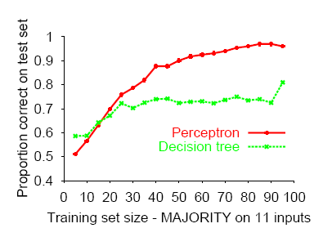
Perceptron learns majority function easily,
DTL is hopeless

Slide 70
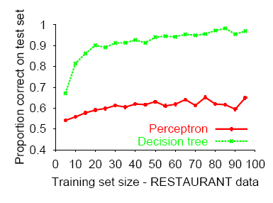
DTL learns restaurant function easily,
perceptron cannot represent it

Slide 71
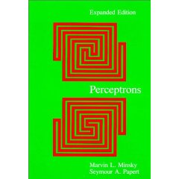
Good news: Adding hidden layer allows more target functions to be represented.
Minsky & Papert (1969)

Slide 72
Multi-layer Perceptrons (MLPs)
Single-layer perceptrons can only represent linear decision surfaces.
Multi-layer perceptrons can represent non-linear decision surfaces.
Hidden
Layer

Slide 73
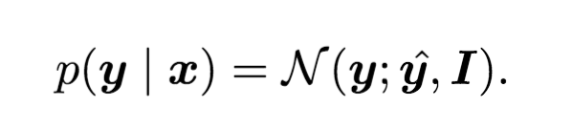
Output units
The choice of how to represent the output then determines the form of the cross-entropy function
1. Linear output z = W^{T} h + b. Often used as mean of Gaussian distribution.
2. Sigmoid function for Bernoulli distribution. Output P(y=1 | x)

Slide 74
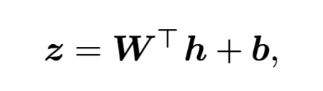
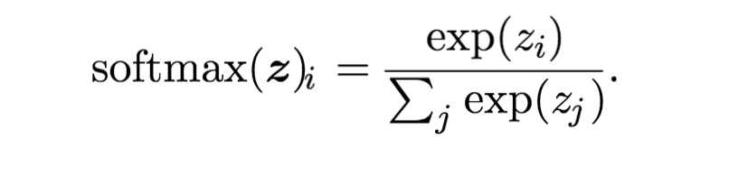
Output units
3. Softmax for Multinoulli output distributions. Predict a vector, each element being P(y = i| x)
A linear layer
Softmax function

Slide 75
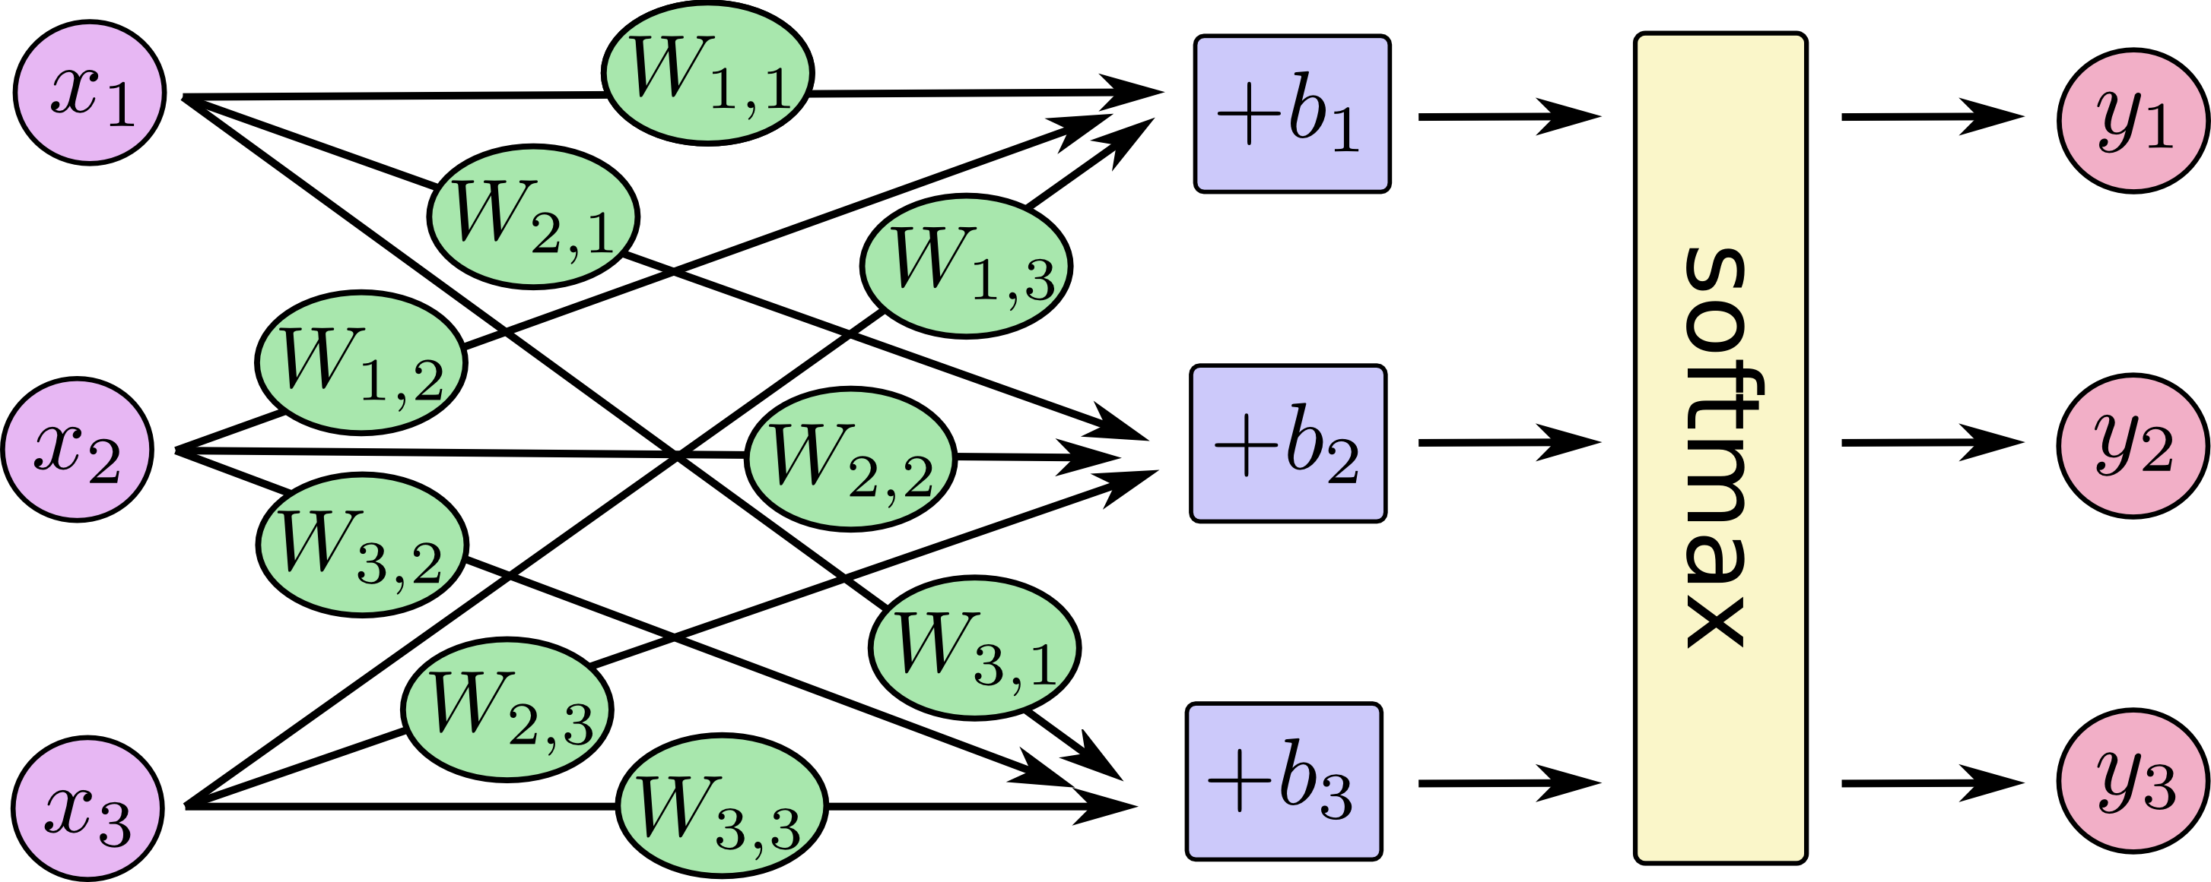
Hidden Layer
Output Layer

Slide 76
Bad news: No algorithm for learning in multi-layered networks, and no convergence theorem was known in 1969!
Minsky & Papert (1969) “[The perceptron] has many features to attract attention: its linearity; its intriguing learning theorem; its clear paradigmatic simplicity as a kind of parallel computation. There is no reason to suppose that any of these virtues carry over to the many-layered version. Nevertheless, we consider it to be an important research problem to elucidate (or reject) our intuitive judgment that the extension is sterile.”
Minsky & Papert (1969) pricked the neural network balloon …they almost killed the field.
Rumors say these results may have killed Rosenblatt….
Winter of Neural Networks 69-86.

Slide 77
Two major problems they saw were
  How can the learning algorithm apportion credit (or blame) to individual weights for incorrect classifications depending on a (sometimes) large number of weights?
  How can such a network learn useful higher-order features?

Slide 78
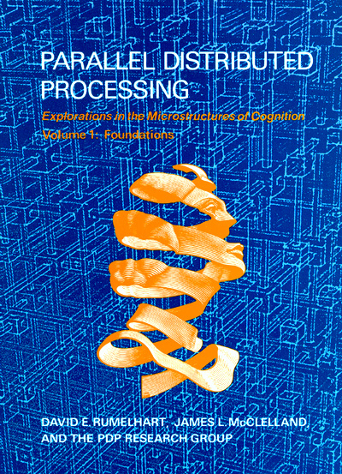
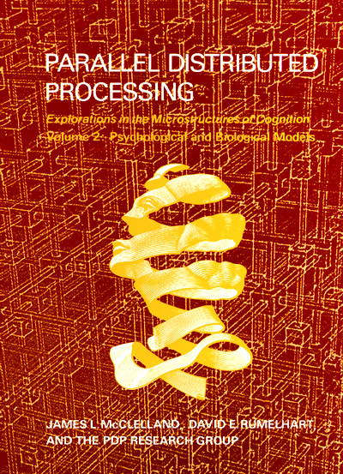
Back Propagation - Next
Good news: Successful credit-apportionment learning algorithms
developed soon afterwards (e.g., back-propagation). Still successful, in
spite of lack of convergence theorem.

